Slide 1
Session:
The Principles of Effective Inclusive Education in a Christian School

Slide 2
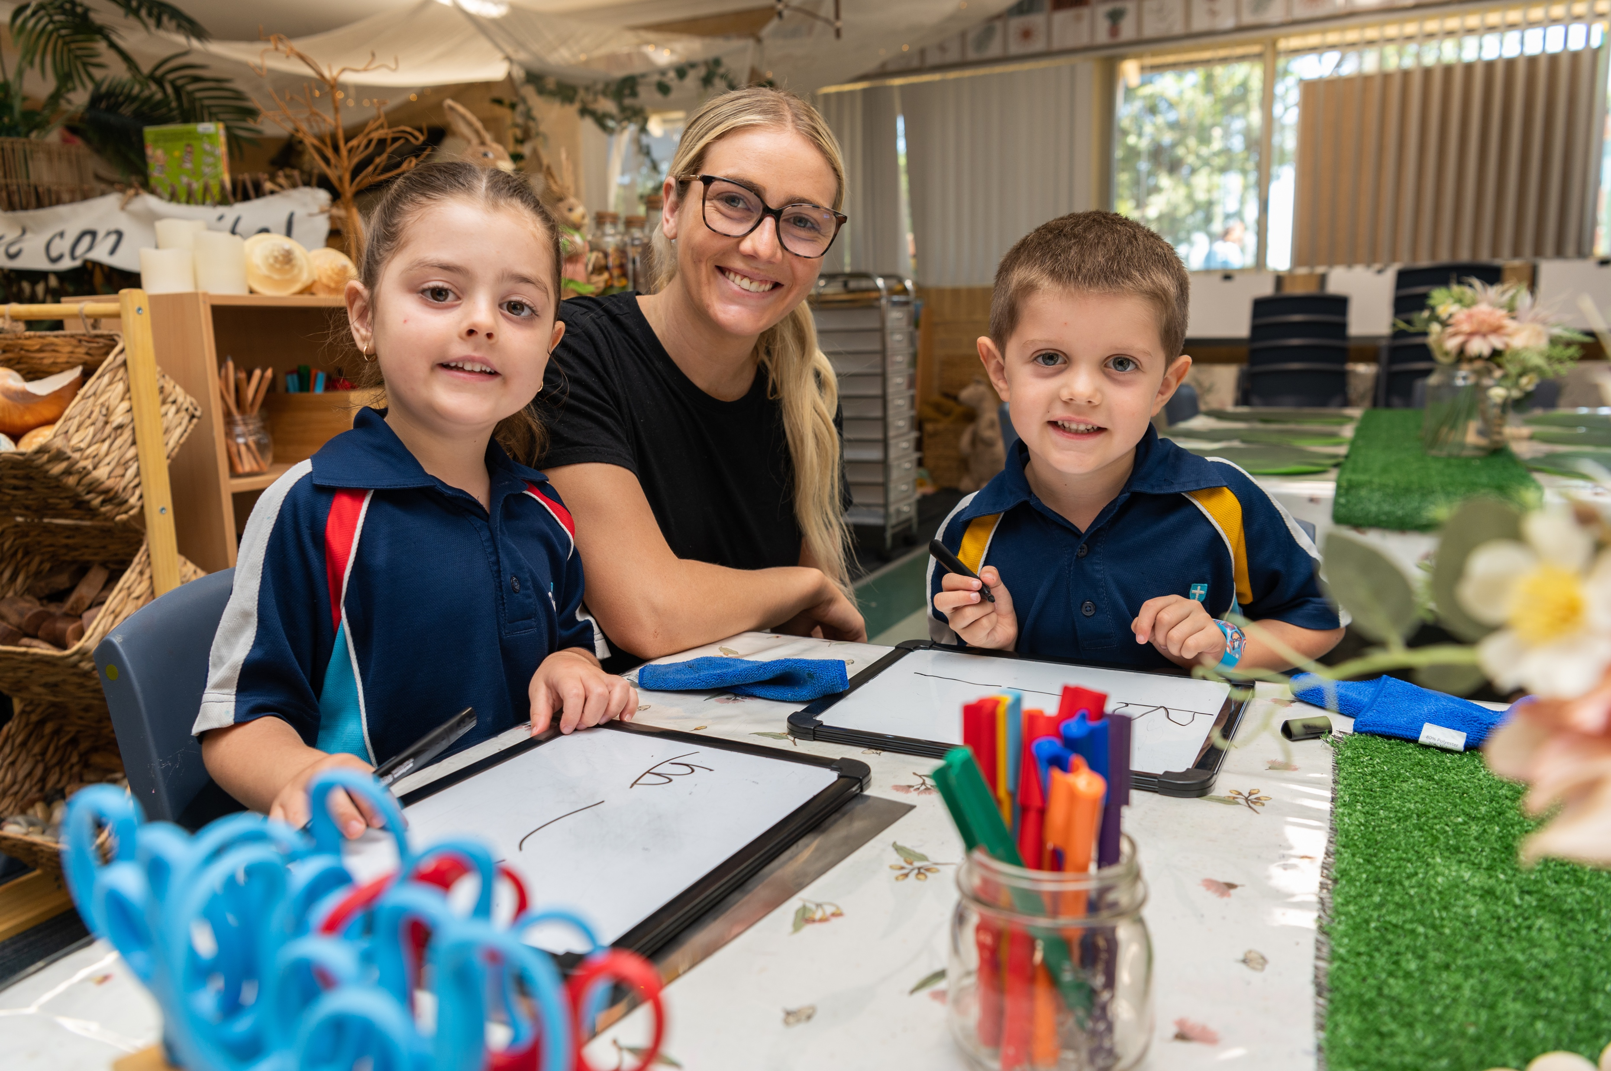
Inclusion in Education
Inclusions: Common understanding, and barriers.
Teachers’ attitudes and a typology of teachers.
Seligman (PERMA +4) Wolterstorff Education of Shalom. Flourishing individual vs flourishing for others.

Slide 3
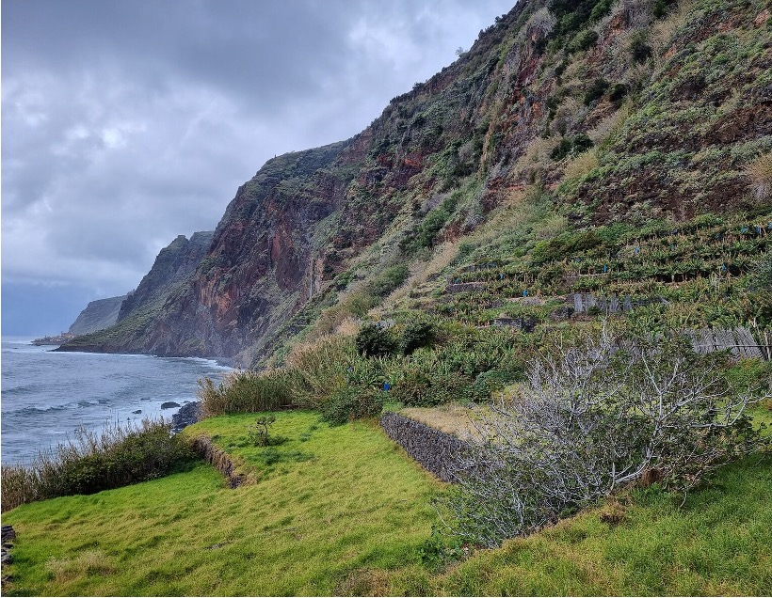
Other people matter
Near the Portuguese island of Madeira, there lies a small island shaped like an enormous cylinder. At the top is a several-acre plateau on which are grown the most prized grapes that go into Madeira wine.
On this plateau lives only one large animal: an ox whose job is to plow the field. There is only one way up to the top, a winding and narrow path.
How in the world does a new ox get up there when the old ox dies? A baby ox is carried on the back of a worker up the mountain, where it spends the next forty years plowing the field alone. If you are moved by this story, ask yourself why.

Slide 4
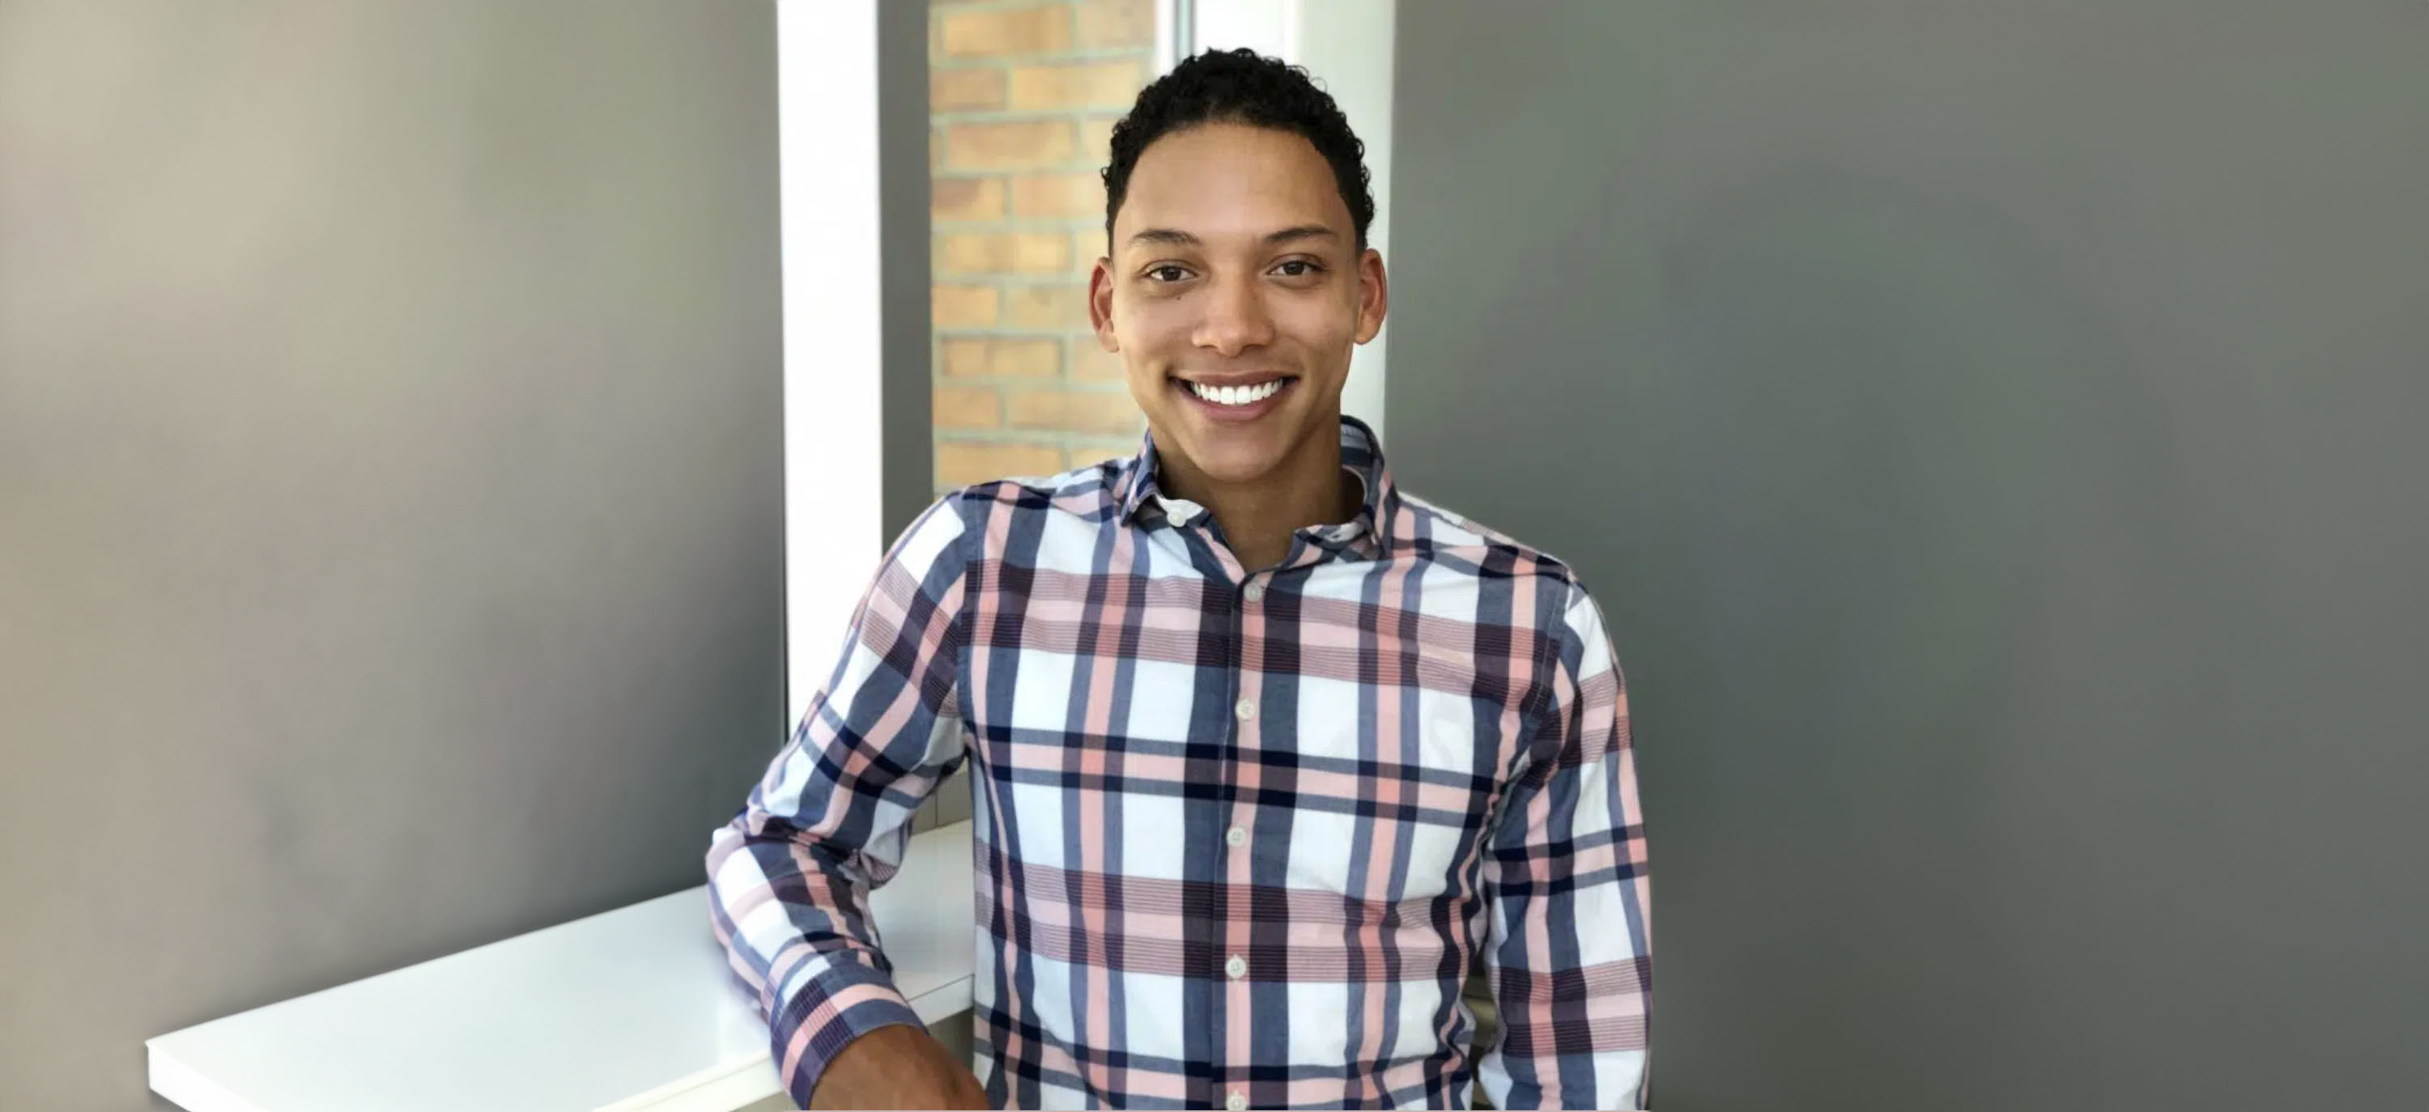
‘Every learner matters and matters equally’
Stop trying to figure out if I am smart and start understanding how I am smart.
- Jemar Lee, Student
Inclusion in education is recognised as a basic human right and as the foundation for a just and equal society.
(European Agency for Development in Special Needs Education, 2012). (UNESCO, 2017, p. 12)

Slide 5
The reason for inclusion
For it was You who created my inward parts; You knit me together in my mother’s womb. I will praise You because I have been fearfully and wonderfully made.
Psalm 139: 13,14
So God created mankind in His own image, in the image of God He created them; male and female He created them.
Genesis 1:27

Slide 6
Moral Reason Why
Disability Discrimination Act
The federal Disability Discrimination Act (1992) (DDA) makes it illegal to harass or discriminate against a person with disability or their associate, on the basis of disability, in the areas of: education
Professional Standards: AITSL
There is a macro and micro approach to inclusive education:
Whole school practices: adjustment to environments, culture, policies, support structures, funding
In-class: differentiating the curriculum, alternative curricula, use of technologies, Doc Plans, and quality teaching for all students

Slide 7
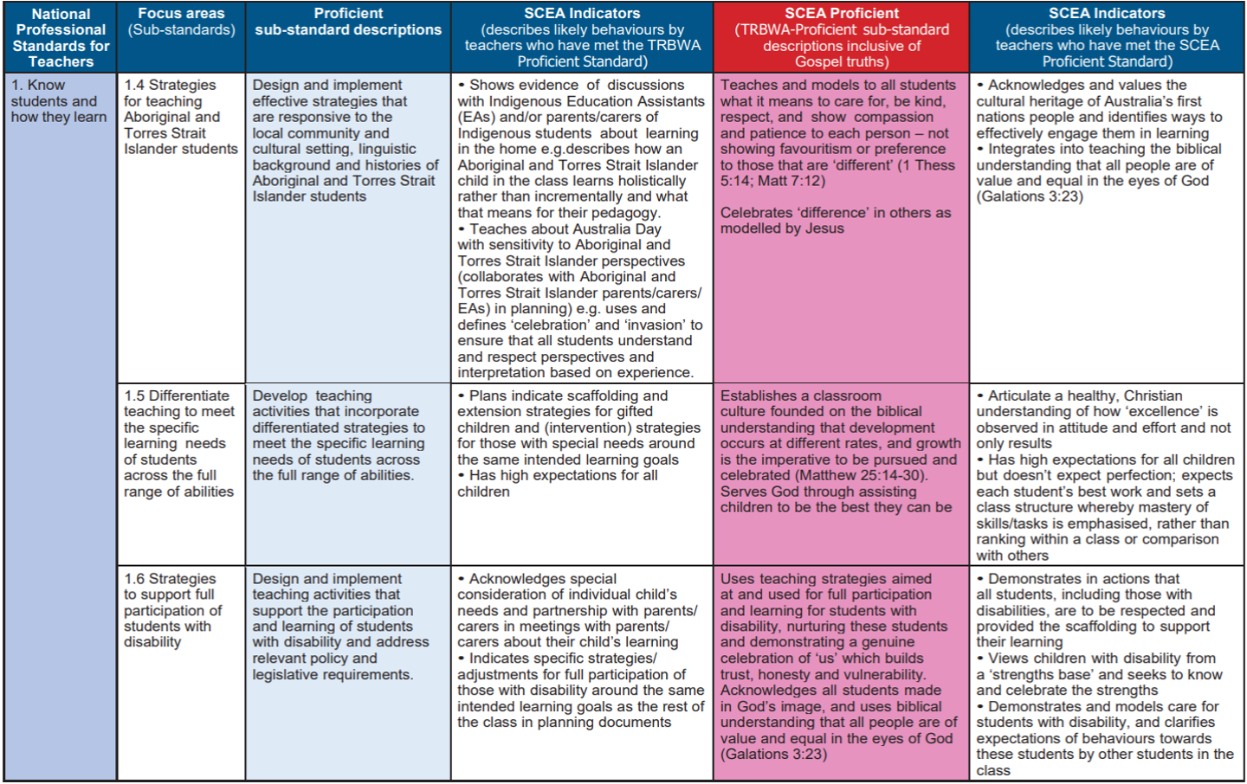

Slide 8
Essential elements of Inclusive Classroom Practices:
Identify and remove barriers.
The right of the student to participate fully in school life and the school’s duty to welcome and accept all students (more than integration).
Barriers as perceived by teachers:
Lack of time​
Difficulty in individualising within a group​
Inadequate training and resources​
Lack of school support​
Views that adjusting for some students compromises the learning of others​
We are not preparing the child for the real world.​

Slide 9
​
STAGES​
Embrace inclusion​
Unquestioningly and with enthusiasm​
Deflation​
Loss of control due to the actions/diagnosis of students, lack of support
​
Responding to deflation​
Analyse to gain control, seek solutions to recapture enthusiasm, experimenting with possibilities, survival by adopting solutions. ​
Emergence of 3 types of teachers ​
Crossroads in dealing with SEN students to ​
try and regain enthusiasm - actions taken ​
signify a type of teacher.​
Teachers who defer to specialist/ Abdicate responsibility.​
Adapt pedagogy / Pragmatists.​
Take action / Reconstituted Enthusiast.
Teachers deal with the inclusion of ASD students in their mainstream classrooms by moving through stages ​
(theoretical proposition) ​
​
Abdicator​
Pragmatist​
Reconstituted Enthusiast

Slide 10
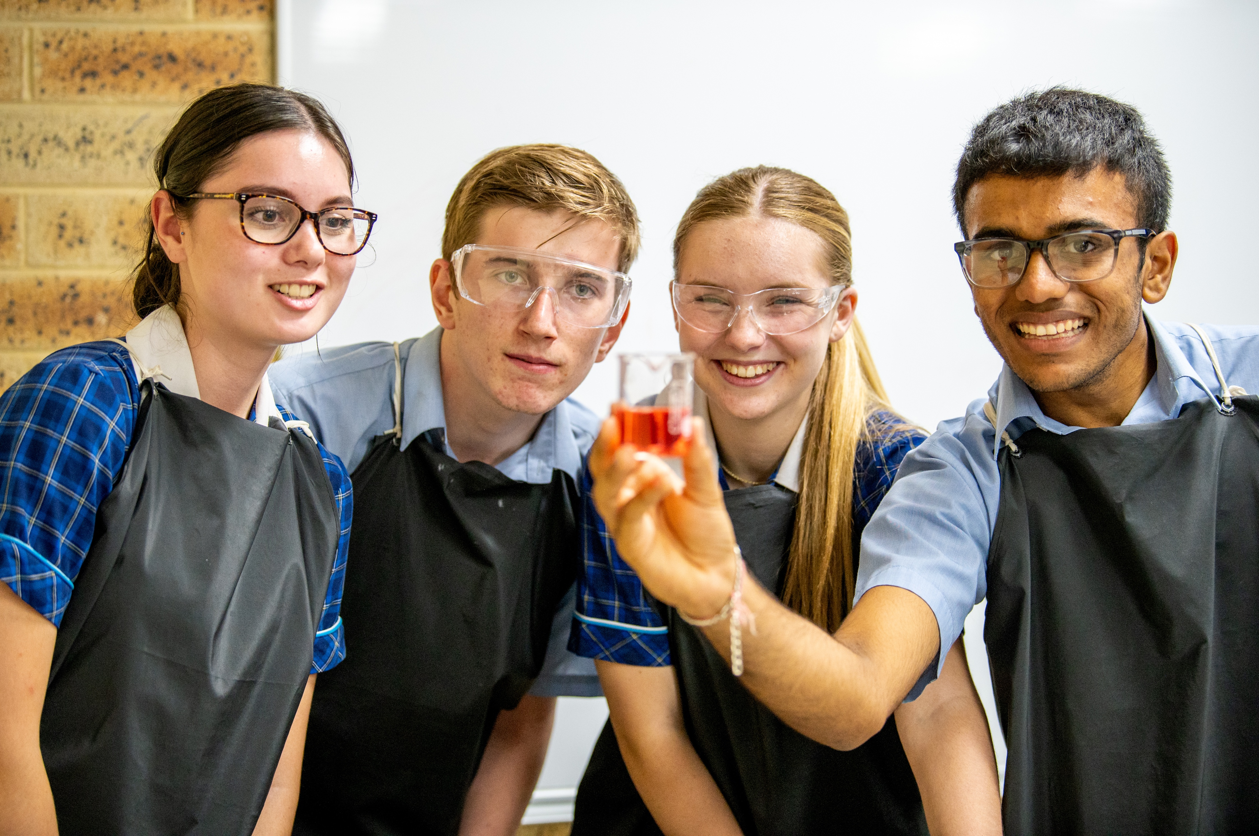
Flourishing individuals vs Flourishing for others
What is positive psychology?
Seligman PERMA +4 for happiness and wellbeing:
Positive emotion
Engagement
Relationships
Meaning
Accomplishment (physical health / mindset / physical work environment / economic security)

Slide 11
Love the Lord your God …
Wolterstorff: Education for Shalom (love and justice)​
To dwell in shalom is: ​
to enjoy living before God​
to enjoy living in one’s physical surroundings​
to enjoy living with one’s fellows ​
to enjoy life with oneself​

Slide 12
Thank You

